Slide 1
Pastoral Care October 2017

Slide 2
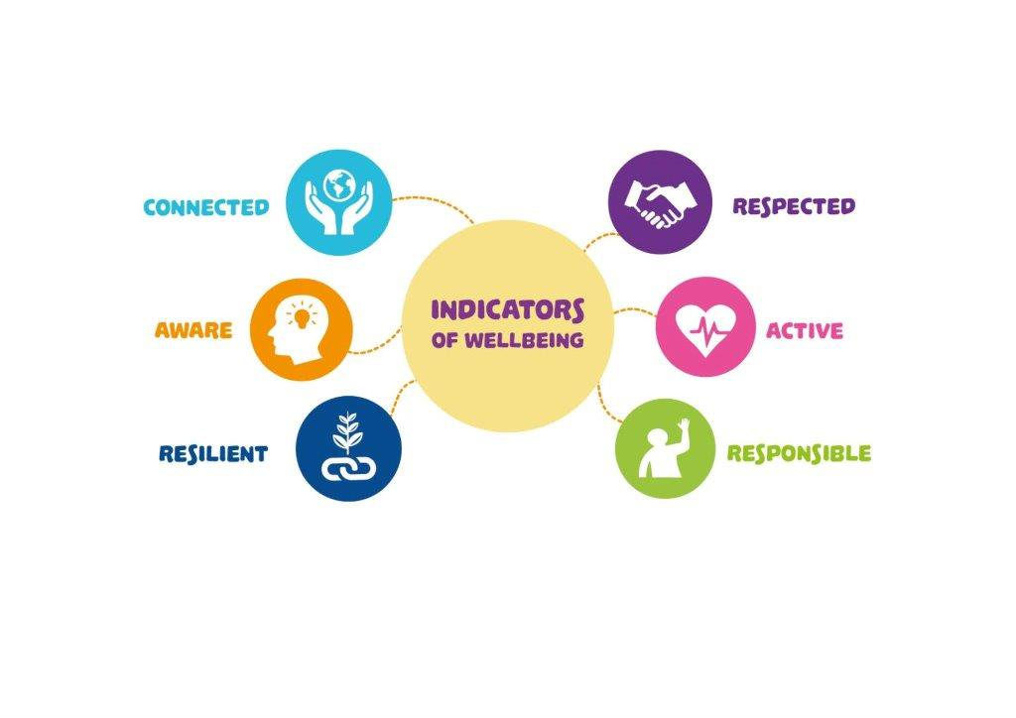

Slide 4
Wellness Pastoral Care
October – Connect
November – Resilient
December-Aware
January- Active
February- Responsible
March- Respected
April – Core Strengths
May- Overview

Slide 5
Pastoral Care October - Connect
Connect
Evidence shows that good relationships with family and friends and the wider community are important for mental wellbeing.

Slide 6
Pastoral Care October - Connect
Many of us would like to spend more time with the people who are most important to us but sometimes life just gets in the way of that. We must make time to connect with the people that matter to us. By nurturing these relationships we feel happier and more secure, giving a better sense of purpose.

Slide 8
Some tips to stay connected:
1. Make time each day to connect with your family and friends . This could include ‘family time’ that is a fixed time to connect each day.

Slide 9
Some tips to stay connected:
2. Most people connect on social media sites like Facebook but face to face contact is so much more meaningful and beneficial than a “like” or “comment” on Facebook.

Slide 10
Some tips to stay connected:
3.Reduce your screen time when you are in company. Put the phone away, close your laptop, turn off the TV and have a chat.

Slide 11
Pastoral Care October –Connect
“The most important things in life are the connections you make with others” Henry Ford

